Slide 1


Dr. T. THIMMAIAH INSTITUTE OF TECHNOLOGY
(Estd. 1986) Oorgaum, Kolar Gold Fields, Karnataka – 563120
(Affiliated to VTU, Belgaum, Approved by AICTE - New Delhi)
NAAC Accredited 'A' Grade, NBA Accredited (CSE, ECE, Mining Engg) Program
DEPARTMENT OF COMPUTER SCIENCE AND ENGINEERING
Project Review-1 Presentation
on
“Automatic Detection of Motorcycle Registration Number
in case of Helmet Rule Violation by Motorcyclists”
Under the Guidance of
Dr. Mohamed Kareemulla
Professor, Dept. of CSE
Dr. TTIT, K.G.F
Presented By
Ajay K M 1GV21CS005
Dhanush M 1GV21CS020
Harish V 1GV21CS025
Manjunatha R 1GV21CS043

Slide 2
Automatic Detection of Motorcycle Registration Number in case of Helmet Rule Violation by Motorcyclists 2024-25
PRESENTATION OUTLINE
INTRODUCTION
LITERATURE SURVEY
REQUIREMENTS
Dept. of CSE, Dr.TTIT, KGF 1

Slide 3
Automatic Detection of Motorcycle Registration Number in case of Helmet Rule Violation by Motorcyclists 2024-25
INTRODUCTION
Road safety.
Data of Ministry of Road Transport and Highways.
Traditional methods
Use of Computer Vision and Deep Learning.
Dept. of CSE, Dr.TTIT, KGF 2

Slide 4
Automatic Detection of Motorcycle Registration Number in case of Helmet Rule Violation by Motorcyclists 2024-25
Objective
To enhance road safety by developing an automated, real-time detection system.
Abstract
To enhance road safety by developing an automated system that detects motorcyclists without helmets and extracts their vehicle registration numbers for enforcement.
Using YOLOv8 and Tesseract OCR.
Dept. of CSE, Dr.TTIT, KGF 3

Slide 5
Automatic Detection of Motorcycle Registration Number in case of Helmet Rule Violation by Motorcyclists 2024-25
Motivation
The motivation is to save lives by promoting helmet compliance.
Scope
Helmet Violation Detection
License Plate Recognition
Data Storage
Scalability and Future Enhancements
Dept. of CSE, Dr.TTIT, KGF 4

Slide 6
Automatic Detection of Motorcycle Registration Number in case of Helmet Rule Violation by Motorcyclists 2024-25
Applications
Traffic law Enforcement.
Road Safety Improvement.
Smart City Integration.
Vehicle Tracking
Toll Management
Traffic Data Analysis
Cross-Violation Detection
Dept. of CSE, Dr.TTIT, KGF 5

Slide 7
Automatic Detection of Motorcycle Registration Number in case of Helmet Rule Violation by Motorcyclists 2024-25
LITERATURE SURVEY
Sl. no | Authors | Title , Journal name, Published year | Methodology | Merits | Demerits
1. 2. 3. | G.Vijendra Reddy, Swathi B. Gopinath, Arun Raj, Karthik.S Praveen S Patil, AkshayBari, Mahesh Waghmode | A Comprehensive Review on Helmet Detection and Number Plate Recognition. 2024. Detection of Helmet and License Plate Using Machine Learning 2024. Revolutionizing Number Plate Detection Machine Learning 2024. | Reviews various object detection approaches including Faster R-CNN and SSD. Utilizes Machine Learning algorithms to detect helmets and recognize license plates from images. Explores advanced machine learning techniques for vehicle classification. | Provides a comparative analysis of different techniques,highlights their performance metrics. Demonstrates the application of machine learning in traffic monitoring and safety enforcement. Discusses the evolution of methodologies in the field. | Lack experimental validation. Specific details on the algorithms used their performance metrics are not provided. Specific implementation details are not provided.
Dept. of CSE, Dr.TTIT, KGF 6

Slide 8
Automatic Detection of Motorcycle Registration Number in case of Helmet Rule Violation by Motorcyclists 2024-25
Sl. no | Authors | Title , Journal name, Published year | Methodology | Merits | Demerits
4. 5. 6. | Dipti Prajapati, Samishtarani Sabat. V, Sri Uthra, et al. Adithya Krishna R, Sandeep P. | Helmet Detection and Number Plate Recognition Using YOLOv8 and TensorFlow. 2024 Real-Time Helmet Detection and Number Plate Extraction Using Computer Vision 2024 Camera-mounted Helmet Detection with YOLOv8 on Custom Dataset 2024 | Employs the YOLOv8 model and tensorflow to detect helmets. Utilizes video surveillance and deep learning model for detection of helmet. Investigates the use of YOLOv8 for helmet detection using a camera. | Emphasizes real-time processing capabilities and potential for traffic. Emphasizes real-time processing and automation in traffic law enforcement. Highlights the importance of accurate license plate location. | Implementation specifies are not provided. Performance metrics are not detailed. Specific implementation details and performance metrics are not provided.
Dept. of CSE, Dr.TTIT, KGF 7

Slide 9
Automatic Detection of Motorcycle Registration Number in case of Helmet Rule Violation by Motorcyclists 2024-25
Sl. no | Authors | Title , Journal name, Published year | Methodology | Merits | Demerits
7. 8. 9. | M Saravanan Swapna Ranikura, Suman Rathlavanth,Sai kumar. M.Thirunavukkarasu, Bugade Amoolya. | Study on the Development of an Automatic Helmet Violation Detection System. 2024 Helmet Detection and Number Plate Recognition Using Deep Learning. 2024 Helmet Detection and License Plate Recognition. 2021 | Focuses on developing an automated system. Utilizes deep learning approaches for detecting helmets. Uses HOG for bike detection ,CNN for helmet detection. | Emphasizes real-time processing capabilities and integration in traffic. Highlights the potential of deep learning in enhancing detection accuracy Real-time automatred, reduces manual monitoring. | Implementation specifies are not provided. Lack of Performance analysis. Performances drops in poor lighting, struggles with non-standard plates.
Dept. of CSE, Dr.TTIT, KGF 8

Slide 10
Automatic Detection of Motorcycle Registration Number in case of Helmet Rule Violation by Motorcyclists 2024-25
Present System
Traffic Monitoring Systems.
License Plate Recognition.
Manual Intervention.
High Cost.
Dept. of CSE, Dr.TTIT, KGF 9

Slide 11
Automatic Detection of Motorcycle Registration Number in case of Helmet Rule Violation by Motorcyclists 2024-25
Gaps in Existing Systems
Helmet Detection Accuracy
Motorcycle Plate Issues
Slow Enforcement
Cost and Scalability
Image suggestion
Corruption
Dept. of CSE, Dr.TTIT, KGF 10

Slide 12
Automatic Detection of Motorcycle Registration Number in case of Helmet Rule Violation by Motorcyclists 2024-25
Proposed System
Four-Phase Detection Pipeline
Motorcycle and Rider Detection
Helmet Detection
License Plate Detection
Character Recognition
Real-Time Performance
Data Logging
Enhanced Accuracy
Dept. of CSE, Dr.TTIT, KGF 11

Slide 13
Automatic Detection of Motorcycle Registration Number in case of Helmet Rule Violation by Motorcyclists 2024-25
Requirements
Hardware Requirements
Processor
GPU (Essential for DL)
RAM
Storage
Dept. of CSE, Dr.TTIT, KGF 12

Slide 14
Automatic Detection of Motorcycle Registration Number in case of Helmet Rule Violation by Motorcyclists 2024-25
Software Requirements
Operating System
Programming Language.
Deep Learning Frameworks:
YOLOv8(Ultralytics)
TensorFlow/PyTorch
OpenCV
Dept. of CSE, Dr.TTIT, KGF 13

Slide 15
Automatic Detection of Motorcycle Registration Number in case of Helmet Rule Violation by Motorcyclists 2024-25
Tesseract OCR : for extracting license plate numbers.
Data Formats:
Images: JPEG, PNG
Videos: MP4, AVI, MKV
Database: SQLite / MySQL
IDE (for Development):VS Code / Jupyter Notebook / PyCharm.
Dept. of CSE, Dr.TTIT, KGF 14

Slide 16
Automatic Detection of Motorcycle Registration Number in case of Helmet Rule Violation by Motorcyclists 2024-25
PRESENTATION OUTLINE
DESIGN
IMPLEMENTATION
Dept. of CSE, Dr.TTIT, KGF 15

Slide 17
Automatic Detection of Motorcycle Registration Number in case of Helmet Rule Violation by Motorcyclists 2024-25
DESIGN
Modular Stage-wise Detection.
Real-Time Frame-by-Frame Processing.
High-Accuracy Model Selection.
Automatic Data Logging.
Dept. of CSE, Dr.TTIT, KGF 16

Slide 18
Automatic Detection of Motorcycle Registration Number in case of Helmet Rule Violation by Motorcyclists 2024-25
System Architecture
Four-Phase Detection Pipeline
Motorcycle and Rider Detection
Helmet Detection
License Plate Detection
Character Recognition
Dept. of CSE, Dr.TTIT, KGF 17

Slide 19
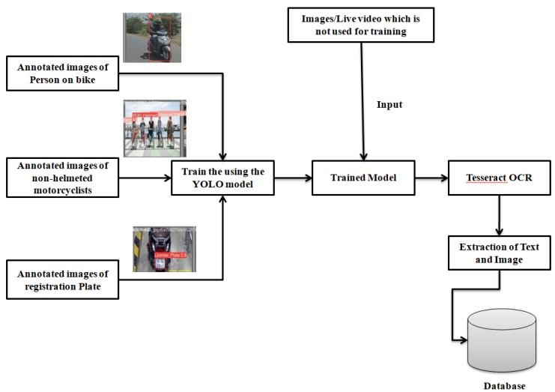
Automatic Detection of Motorcycle Registration Number in case of Helmet Rule Violation by Motorcyclists 2024-25
Diagram
Dept. of CSE, Dr.TTIT, KGF 18

Slide 20
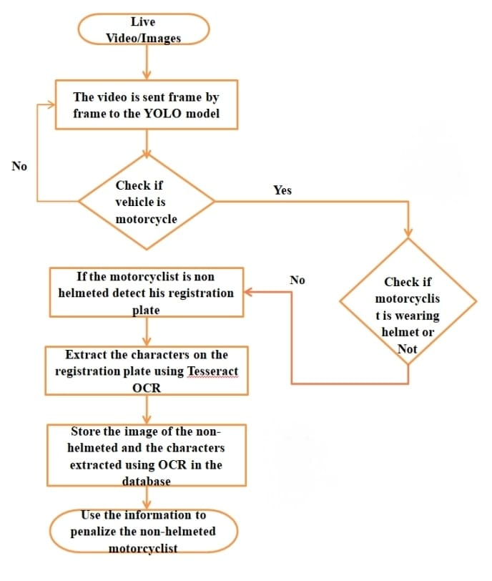
Automatic Detection of Motorcycle Registration Number in case of Helmet Rule Violation by Motorcyclists 2024-25
Flowchart
Dept. of CSE, Dr.TTIT, KGF 19

Slide 21
Automatic Detection of Motorcycle Registration Number in case of Helmet Rule Violation by Motorcyclists 2024-25
MODULE OVERVIEW
Motorcycle and Rider Detection Module
Helmet Detection Module
License Plate Detection Module
License Plate Character Recognition Module
Database Storage Module
Dept. of CSE, Dr.TTIT, KGF 20

Slide 22
Automatic Detection of Motorcycle Registration Number in case of Helmet Rule Violation by Motorcyclists 2024-25
IMPLEMENTATION
MODULE DESCRIPTION
Motorcycle and Rider Detection Module
Purpose:
Identify motorcycles and the riders in images.
Technology:
YOLOv8 (Object Detection Model).
Output:
Bounding boxes around bikes and riders.
Dept. of CSE, Dr.TTIT, KGF 21

Slide 23
Automatic Detection of Motorcycle Registration Number in case of Helmet Rule Violation by Motorcyclists 2024-25
Helmet Detection Module
Purpose:
Check whether the detected rider is wearing a helmet.
Technology:
YOLOv8 (Separate Helmet Classifier)
Output:
Label riders as "Helmeted" or "Non-Helmeted"
Dept. of CSE, Dr.TTIT, KGF 22

Slide 24
Automatic Detection of Motorcycle Registration Number in case of Helmet Rule Violation by Motorcyclists 2024-25
License Plate Detection Module
Purpose: Locate the license plate on motorcycles where helmet violation is detected.
Technology: YOLOv8 (License Plate Detection)
Output: Bounding box around the license plate.
Dept. of CSE, Dr.TTIT, KGF 23

Slide 25
Automatic Detection of Motorcycle Registration Number in case of Helmet Rule Violation by Motorcyclists 2024-25
License Plate Character Recognition Module
Purpose: Recognize and extract the text from the license plate image.
Technology: Tesseract OCR (Optical Character Recognition)
Output: Registration number (text format).
Dept. of CSE, Dr.TTIT, KGF 24

Slide 26
Automatic Detection of Motorcycle Registration Number in case of Helmet Rule Violation by Motorcyclists 2024-25
Database Storage Module
Purpose: Save the detected violation details for record and future action.
Data Stored:
Rider’s Image
License Plate Number
Dept. of CSE, Dr.TTIT, KGF 25

Slide 27
Automatic Detection of Motorcycle Registration Number in case of Helmet Rule Violation by Motorcyclists 2024-25
ALGORITHM
Step 1:Start the system.
Step 2: Capture a frame from the images .
Step 3: Detect if a motorcycle is present in the frame using the first YOLOv8 model.
Step 4: Detect if a person is sitting on the motorcycle.
Step 5: Check if the rider is wearing a helmet using the second YOLOv8 model.
Step 6: Detect the license plate on motorcycle using the third YOLOv8 model.
Step 7: Crop the detected license plate region from the frame.
Step 8: Apply Tesseract OCR to the cropped license plate image.
Step 9: Store the details in database.
Dept. of CSE, Dr.TTIT, KGF 26

Slide 28
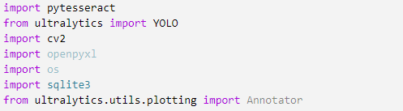
Automatic Detection of Motorcycle Registration Number in case of Helmet Rule Violation by Motorcyclists 2024-25
SAMPLE CODE
Dept. of CSE, Dr.TTIT, KGF 27

Slide 29
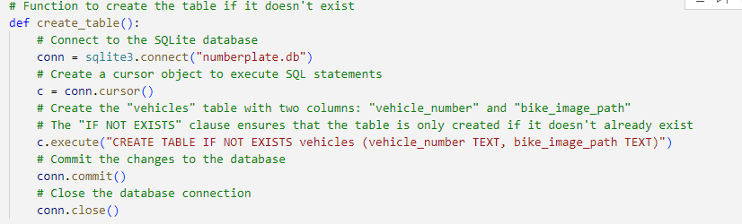
Automatic Detection of Motorcycle Registration Number in case of Helmet Rule Violation by Motorcyclists 2024-25
Dept. of CSE, Dr.TTIT, KGF 28

Slide 30
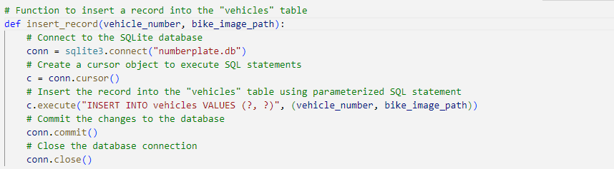
Automatic Detection of Motorcycle Registration Number in case of Helmet Rule Violation by Motorcyclists 2024-25
Dept. of CSE, Dr.TTIT, KGF 29

Slide 31
THANK YOU

